Slide 1
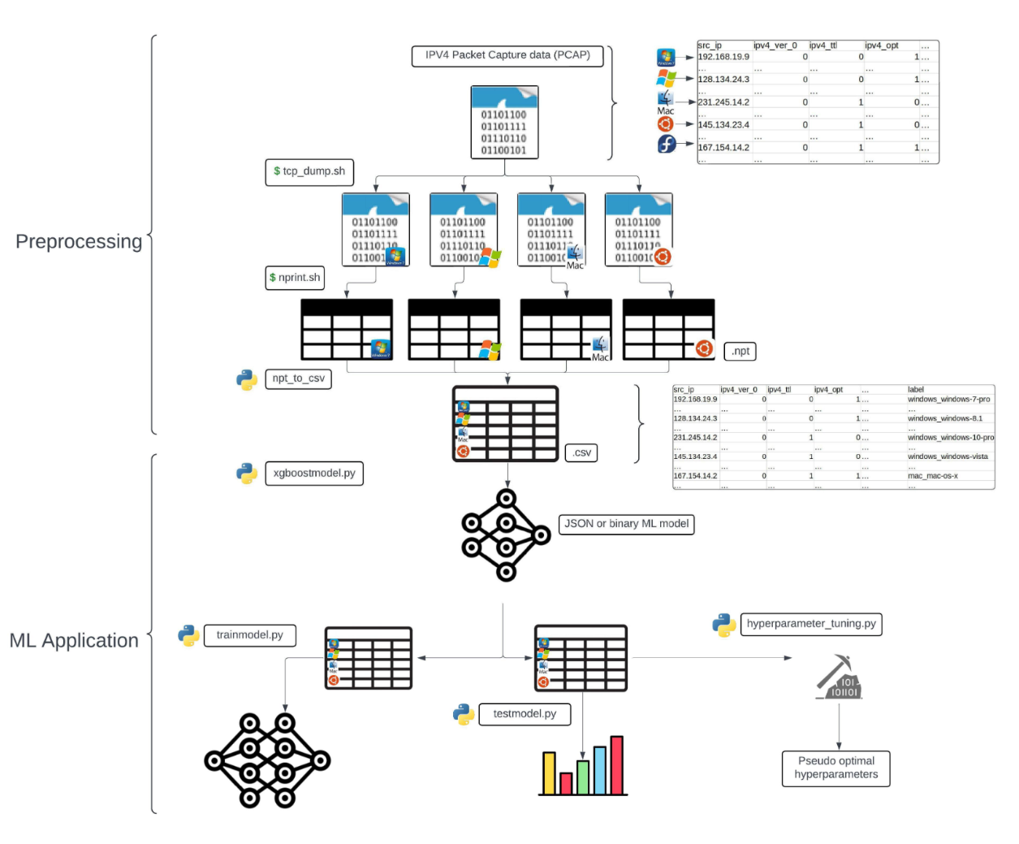
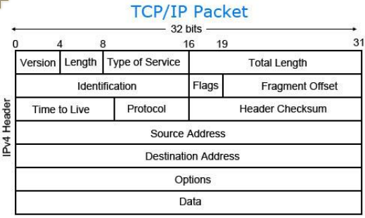
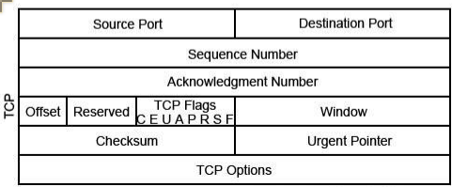
25-345
Network Feature Extraction From High Cyber Fidelity Simulation Environment
Team members: Christopher Castro, Ryan Collette, William Lagos, Sam Soltanian | Faculty adviser: Irfan Ahmed, Ph.D. | Sponsor: DoD ASPIRE | Mentor: Joao Soares
Workflow
Introduction
Improvements
In today’s world, wireless network traffic is ubiquitous. Our devices constantly communicate over networks, creating a rich stream of data.
What if we could tap into this passive flow to identify the operating systems of connected devices without any interaction?
OsirisML is an existing machine learning-based application created by the U.S. Department of Defense, designed to identify the operating systems of devices communicating over a wireless network through packet capture (PCAP) files.
Improve accuracy and add ability to detect OS builds & versions. Model benchmarks at 74.09% and struggles to identify specific versions of operating systems, e.g. Ubuntu 20.1 vs. 24.04
Reduce required memory. Currently requires 405GB RAM to execute.
Containerization to allow deployment across multiple operating systems. The application is currently confined to Debian based OS’s.
Implementing a Command Line Interface for ease of use. Currently each element of the application must be run independently without the assistance of an interactive CLI.
Goal
Expand OsirisML's functionality to identify not only the operating system, but also its specific builds and versions, while also improving general usability.
Packet Identification
OsirisML identifies operating systems by analyzing TCP/IP headers and leveraging machine learning algorithms to detect patterns unique to specific OS versions.
Fragment Id/Offset
Time To Live (TTL),
Initial Sequence Number (ISN)
Other identifiers such as Timestamps, Window Scaling, Maximum Segment Size, Explicit Congestion Notification, Internet Control Message Protocol

